Slide 1

D3 – DATA - DRIVEN DOCUMENTS
Sai HEMANTH VEMULAPALLI

Slide 2
Framework OUTLINE
Introduction to D3
Use cases
Installation instructions
Available features
Examples
Demo
References

Slide 3
Introduction
D3 is a JavaScript library for visualizing data using web standards and manipulating documents based on data
D3 framework was created by Mike Bostock in 2011 along with Heer and Ogievetsky
D3 can also be explained as
Data – provided by you
Driven – It connects data to documents
Documents – these are web-based documents
D3 helps bring data to life by creating data visualization and interactive graphics in web development technologies like SVG, HTML5, CSS.

Slide 4
What is the need to use D3
It is a novel representation-transparent approach to visualization for the web which is extremely versatile.
D3 enables direct inspection and manipulation of a native representation: the standard document object model (DOM).
Dynamic transforms can be applied to both generate and modify content and great control over the final visual result.
We can create HTML5 web pages with D3.
Minimal overhead and is extremely fast and supports large data sets
We can share our work instantly with anyone who uses a web browser.
You can reuse code by using functional style.

Slide 5
Use cases
D3 is used to create:
Graphics
HTML tables and charts – like bubble charts, bullet charts
Techniques interaction and animation
Maps, Mouse/keyboard events
From live events, concert touring, theatre, fixed installs and broadcast, D3 has brought a new way of working

Slide 6
Installation instructions
To install the latest version(4.12.0) visit the site https://d3js.org/
Click on d3.zip to download the zip file
Unzip the file and you can see d3.js and d3.min.js
Use d3.mini.js version if you need minified version or other file
To link directly to the latest release, copy this snippet
<script src=https://d3js.org/d3.v4.min.js></script>

Slide 7
Features
It functions on every web browser and web technologies.
D3 efficiently manipulates documents based on data
D3 has a vibrant open source community
D3's useful style permits code reuse through a different gathering of authority and group created modules
Developer friendly and it enables you to build customized visualisations for any kind of storytelling you could imagine for the web.
Based on user interaction it allows you to change existing data.

Slide 8
Examples
2012 NFL conference Champs
https://thedylanharper.wordpress.com/2013/02/04/2012-nfl-conference-ch
amps/
A Chicago divided by killings
http://www.nytimes.com/interactive/2013/01/02/us/chicago-killings.html
USGS DRG – a static map
https://en.wikipedia.org/wiki/Web_mapping#/media/File:Topographic_map_example.png

Slide 9
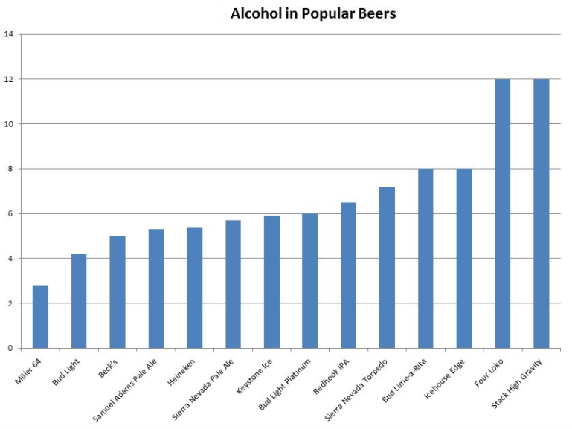
Demo

Slide 10
References
https://d3js.org/
https://www.analyticsvidhya.com/blog/2017/07/beginner-guide-build-data-visualisations-web-d3-js/
Miller, D. (n.d.). 5 Reasons to Learn D3.js. Retrieved October 13, 2017, from http://d-miller.github.io/Why-Learn-D3
Bostock, M. (n.d.). Data-Driven Documents. Retrieved October 13, 2017, from https://d3js.org/

